Slide 2
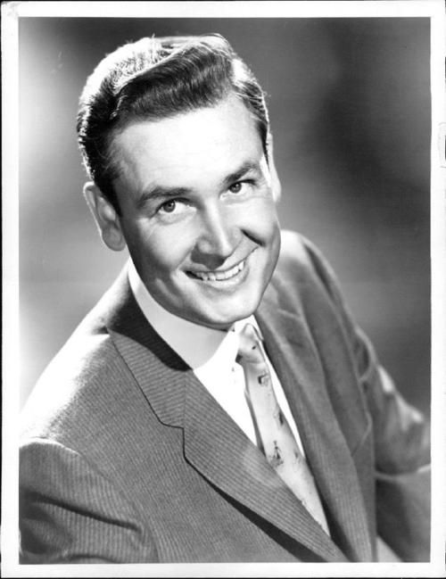
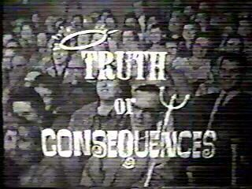
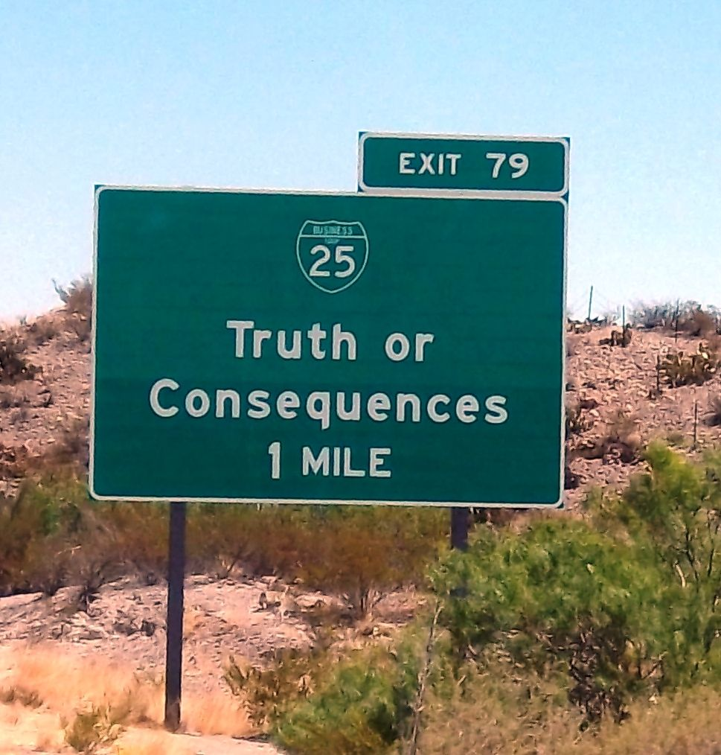

Slide 3
Facing the Truth or the Consequences 1 John 2:19-27

Slide 4
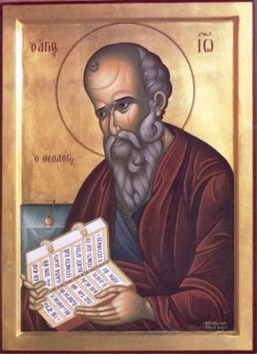
In the letter of First John, the apostle is warning God’s beloved about the conflicts they will face.

Slide 5
“ They went out from us, but they really did not belong to us. For if they belonged to us, they would have remained with us, but their going out showed that none of them belonged to us.” -- 1 John 2:19

Slide 6
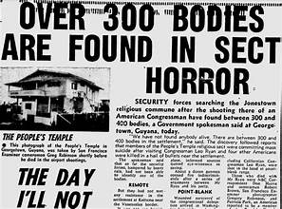
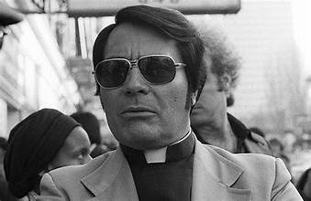
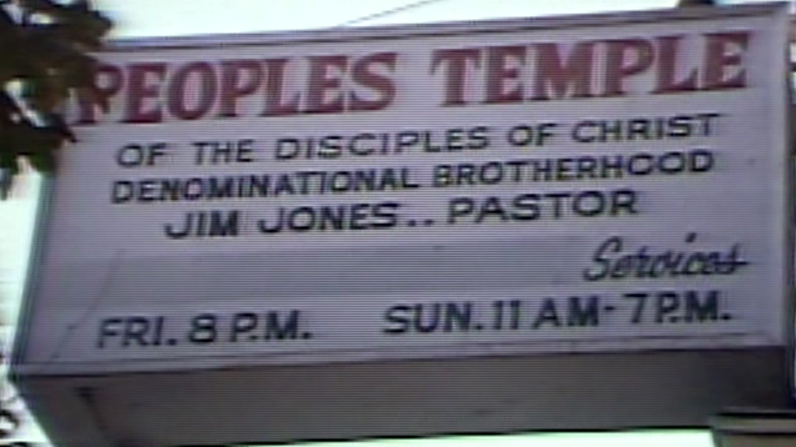

Slide 7
John reminds the believers that they are the ones with the anointing of the Spirit.

Slide 8
John reminds them and us that we already know all that matters.

Slide 9
“All of you know the truth. I do not write you because you do not know the truth, but because you do know it and because no lie comes from the truth.” -- 1 John 2:20b-21

Slide 10
John reminds them they are to remain in the Son and in relationship with one another.

Slide 11
“See that what you have heard from the beginning remains in you… and just as it has been taught you, remain in him.” -- 1 John 2:24,27

Slide 12
Facing the Truth or the Consequences 1 John 2:19-27

